Slide 1
APIC Northeast Ohio - 017
Updating Community Notification Preferences

Slide 2
Go to
http://community.apic.org/northeastohio/home

Slide 3
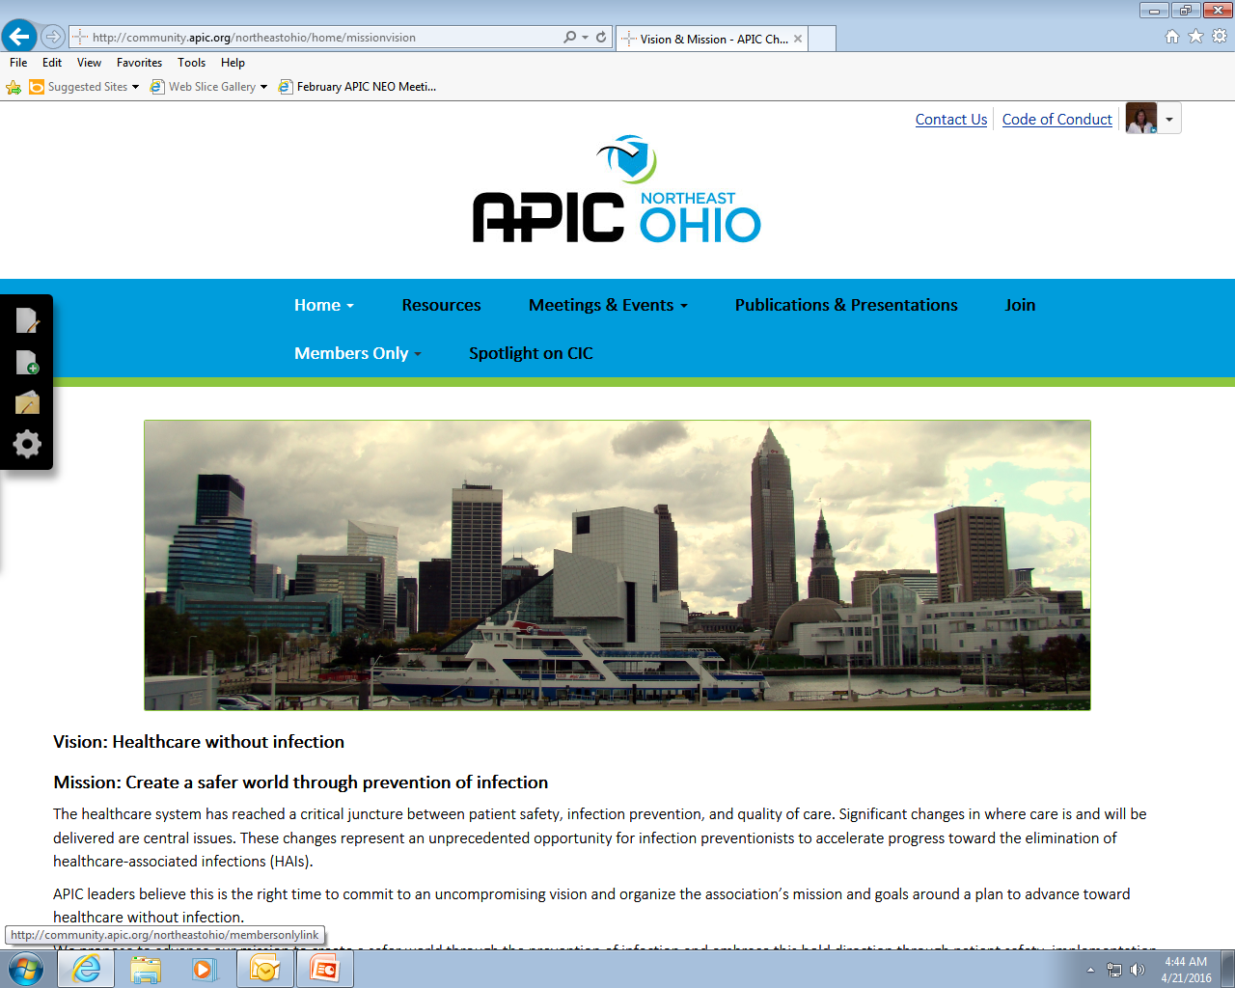
Click on “Members Only” and sign in

Slide 4
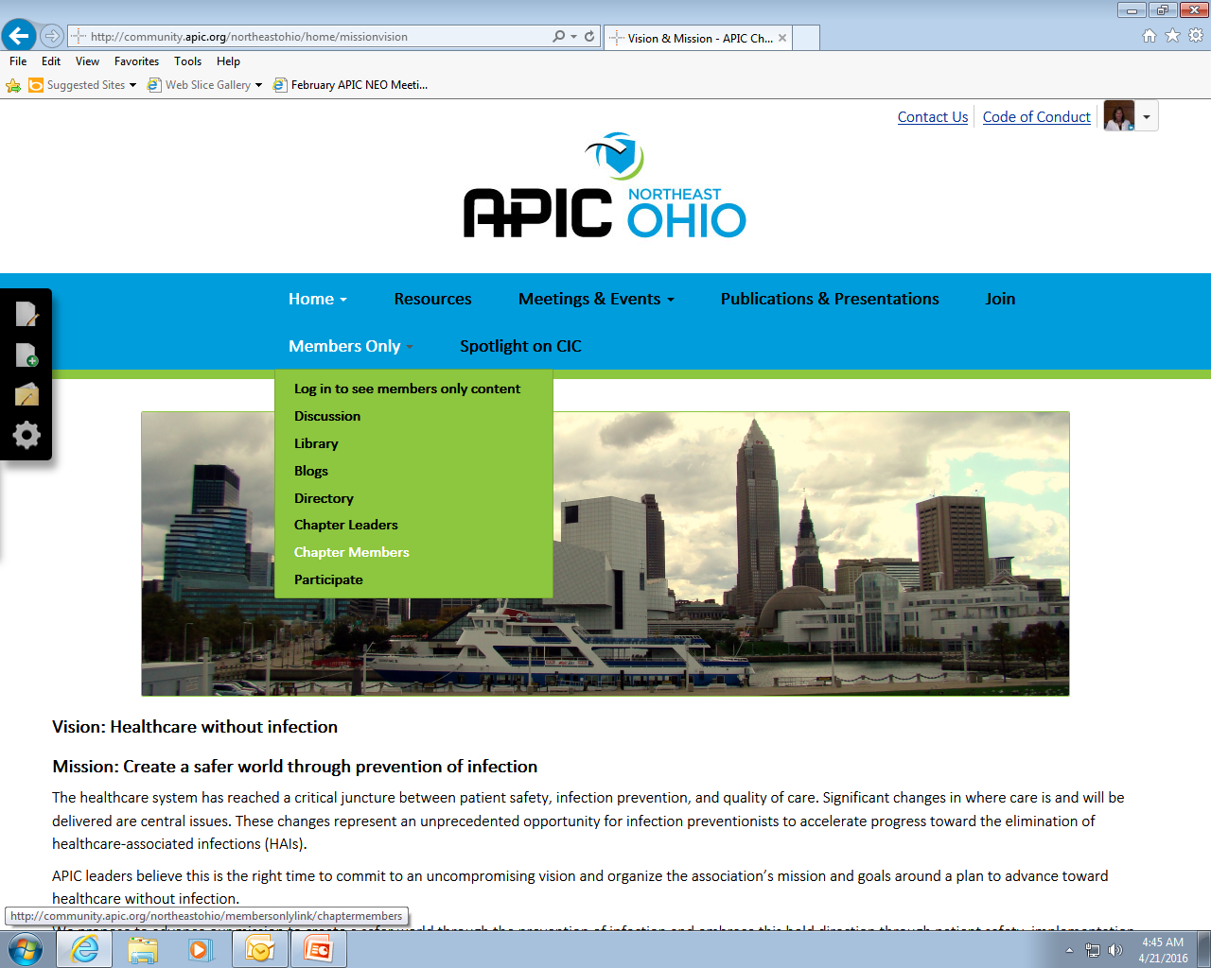
Use Drop down arrow and Choose
“Chapter Members”

Slide 5
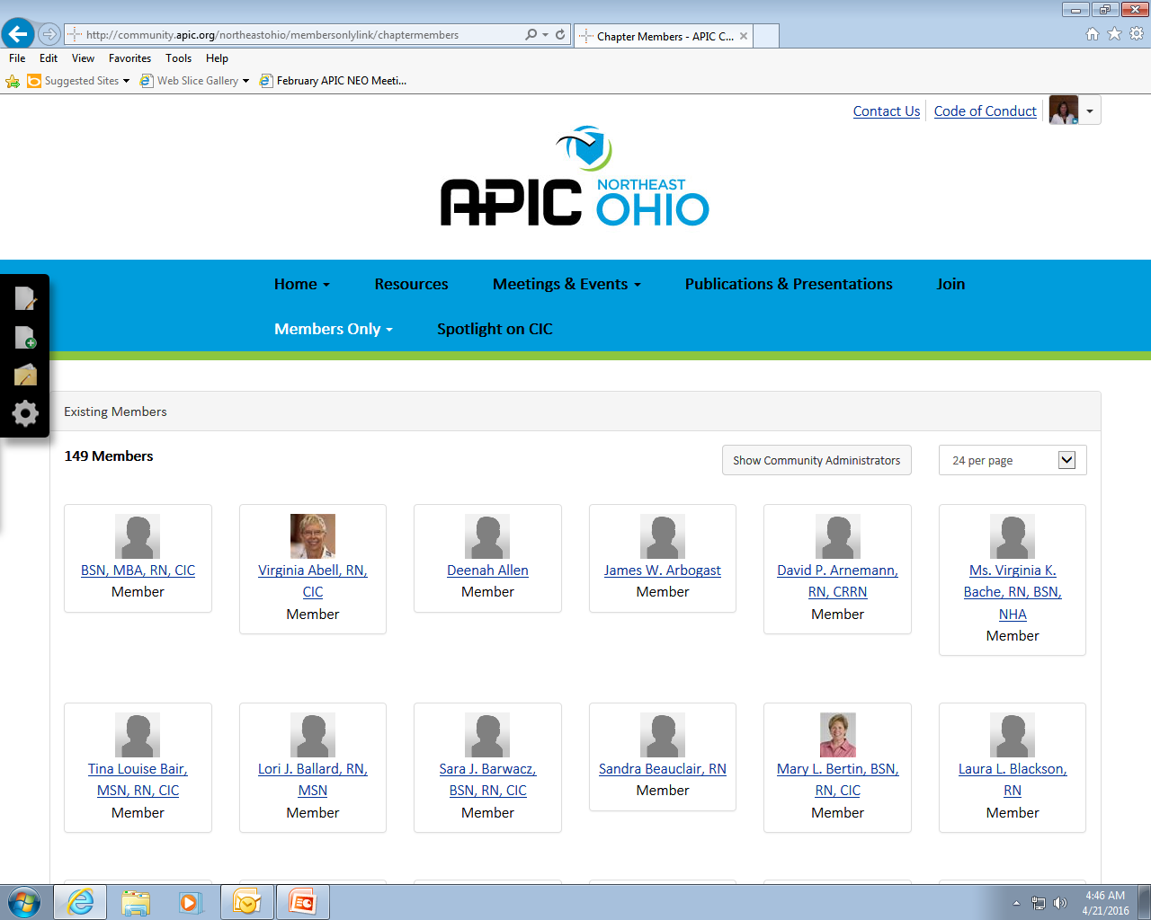
Find your own Member connection by scrolling down if you are not on this page
Scroll bar

Slide 6
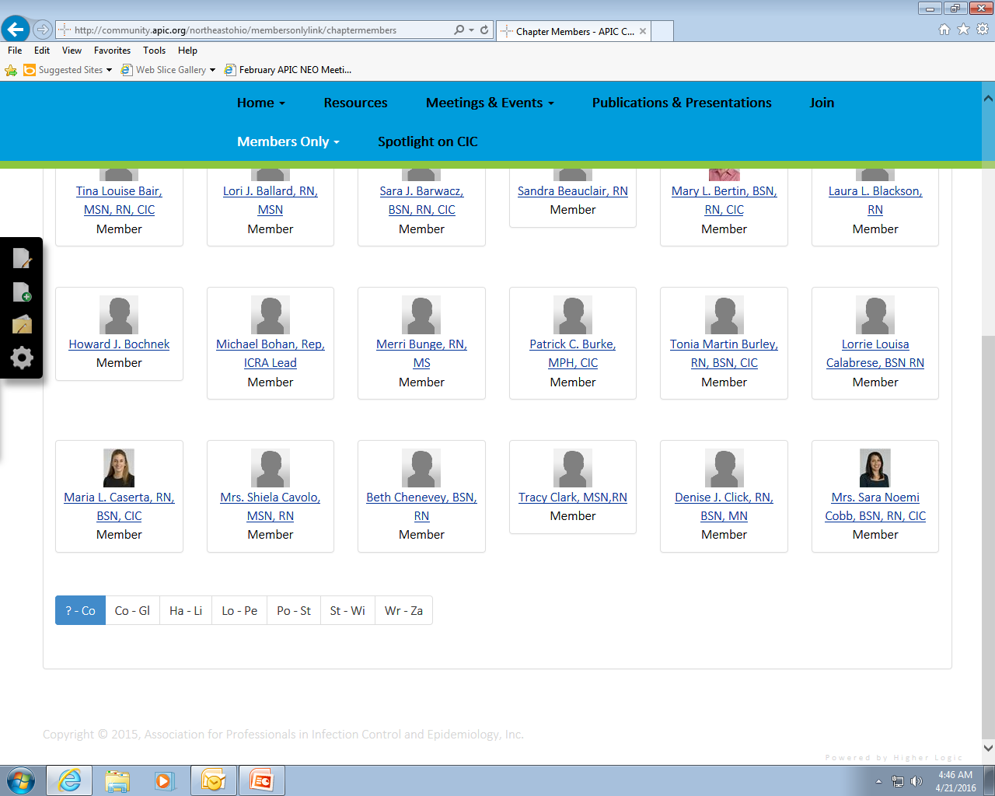
If you are still not visible use the fast links below to go to your page

Slide 7
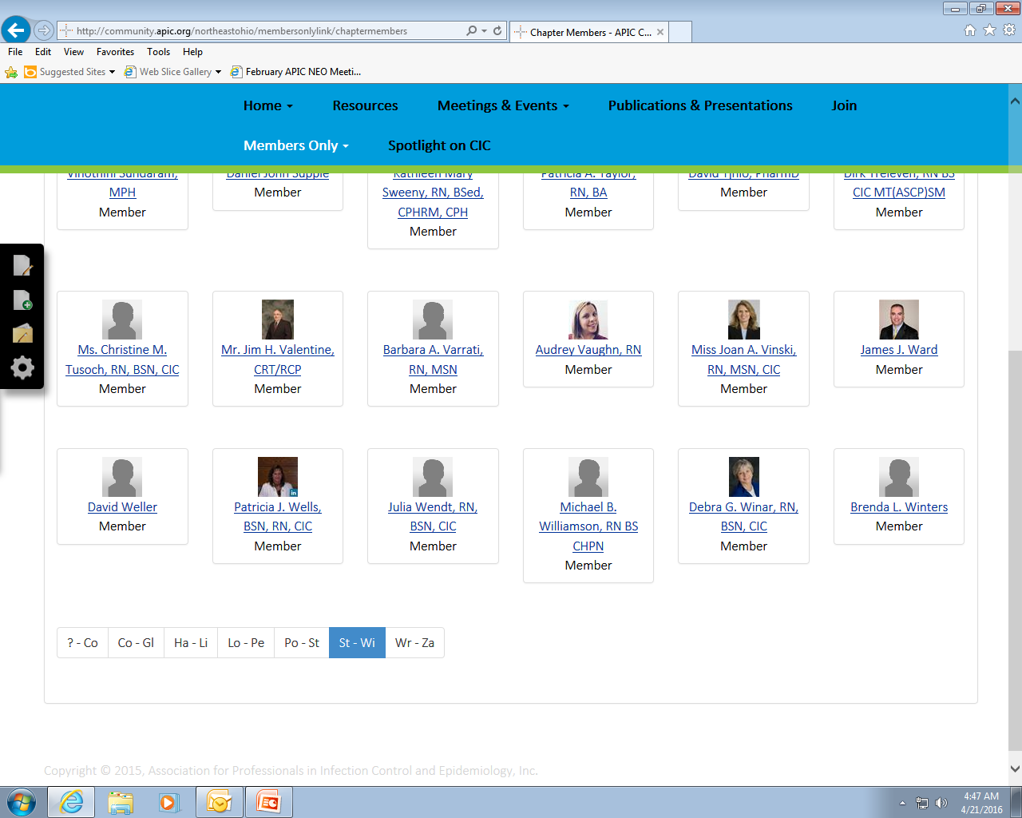
You may need to scroll down the page
Once you find yourself – left click on your name

Slide 8
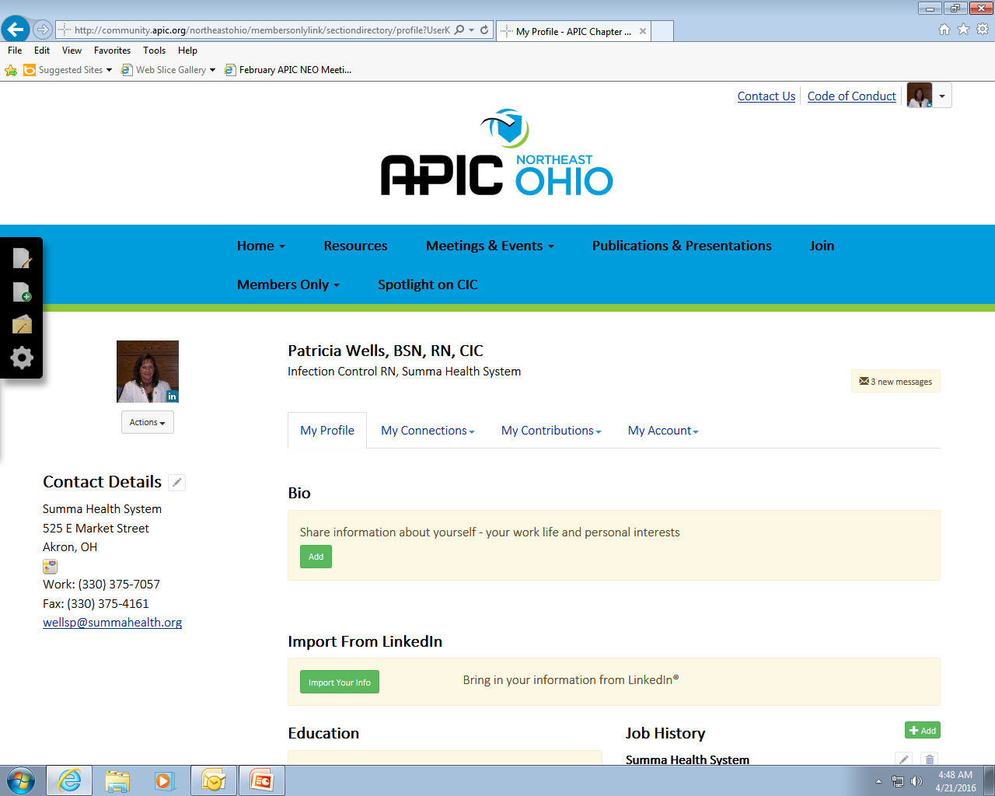
Left click the drop down arrow on “My Account”

Slide 9
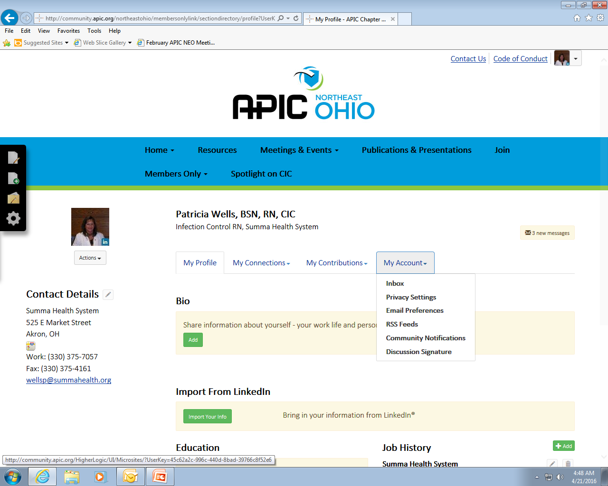
Choose “Community Notifications”

Slide 10
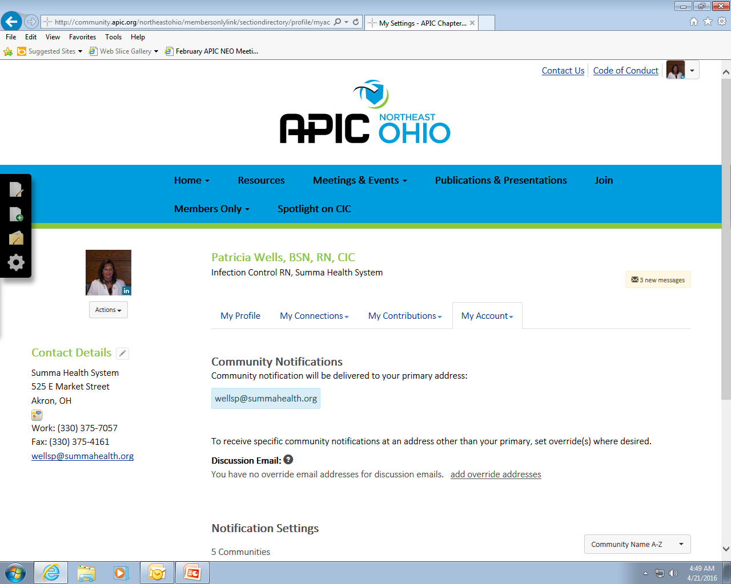
Make sure your e-mail is correct
Then scroll down this page below “Notification Settings”

Slide 11
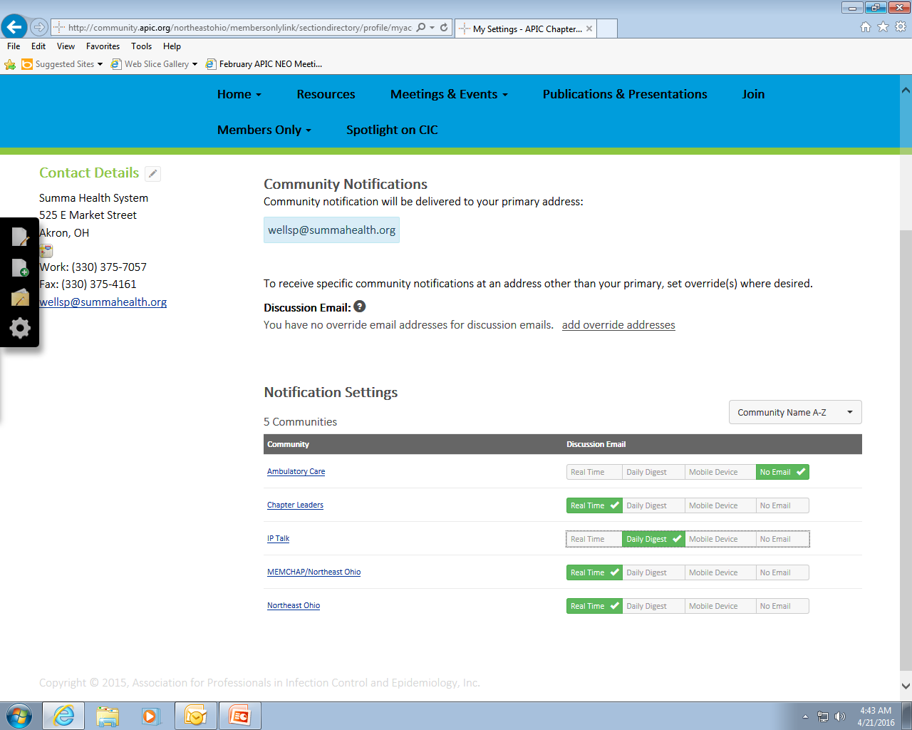
1. Find MEMCHAP/Northeast Ohio
2. Click on “Real Time”

